Slide 1
Docker
Rupesh Panwar
Date: 02-Aug-21

Slide 2
Before we start..
Login-Docker for Windows/Mac
Create Login
https://hub.docker.com/
Login into Docker Lab
https://labs.play-with-docker.com/

Slide 3
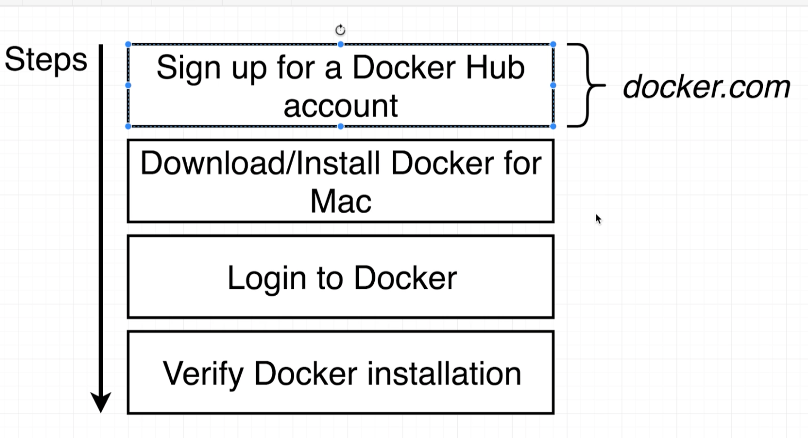
Login-Docker for Windows/Mac

Slide 4
Agenda
What is docker/why we use Docker
Very first Docker terminology
Docker for Windows/Mac-Components
Using Docker client
A container..
How your computer is running Docker

Slide 5
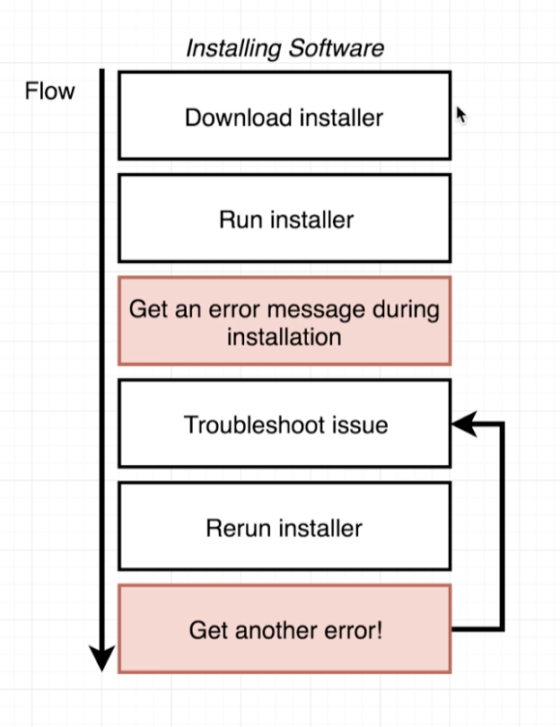
What is Docker/Why we use Docker

Slide 6
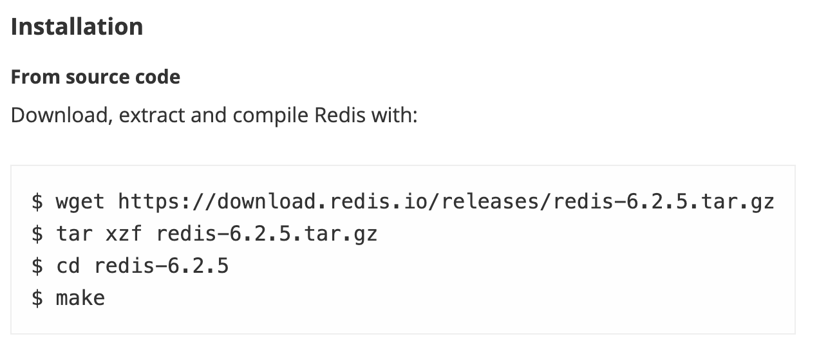
What is Docker/Why we use Docker
https://redis.io/download

Slide 7
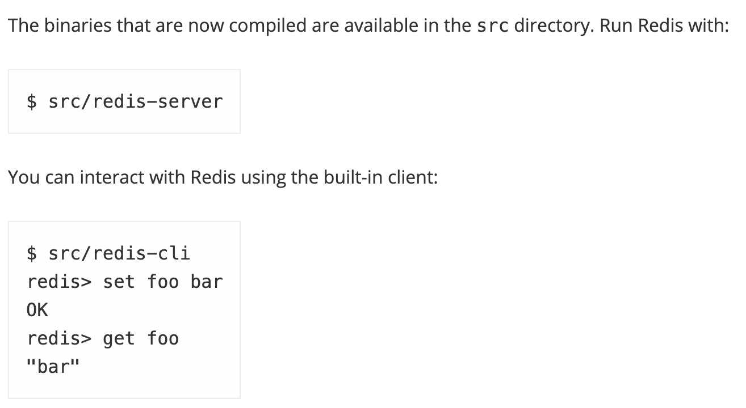
What is Docker/Why we use Docker
https://redis.io/download

Slide 8
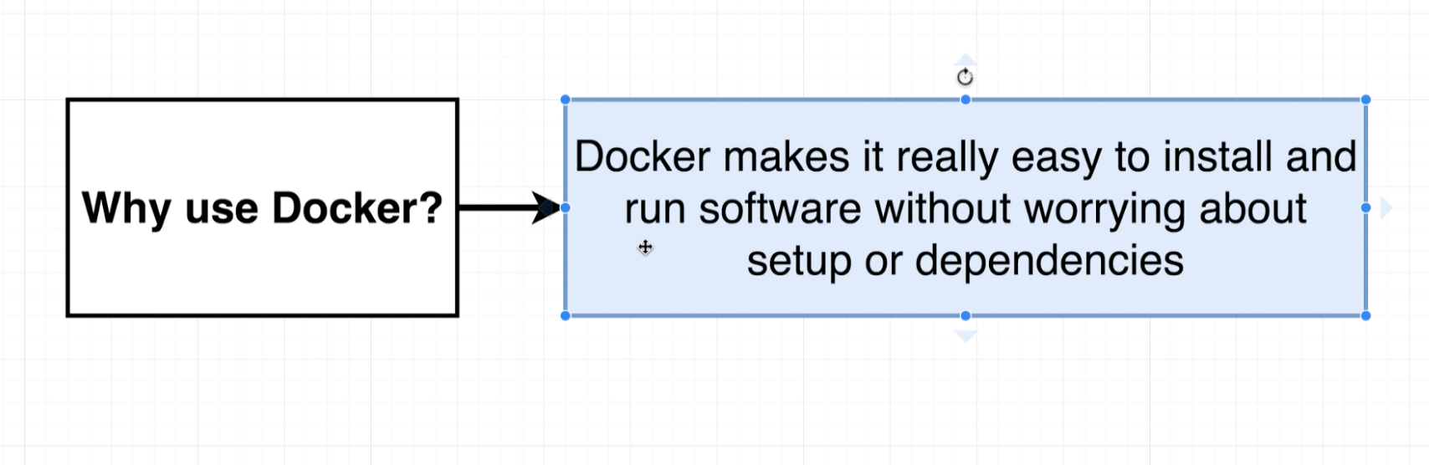
What is Docker/Why we use Docker
Run > docker run -it redis

Slide 9
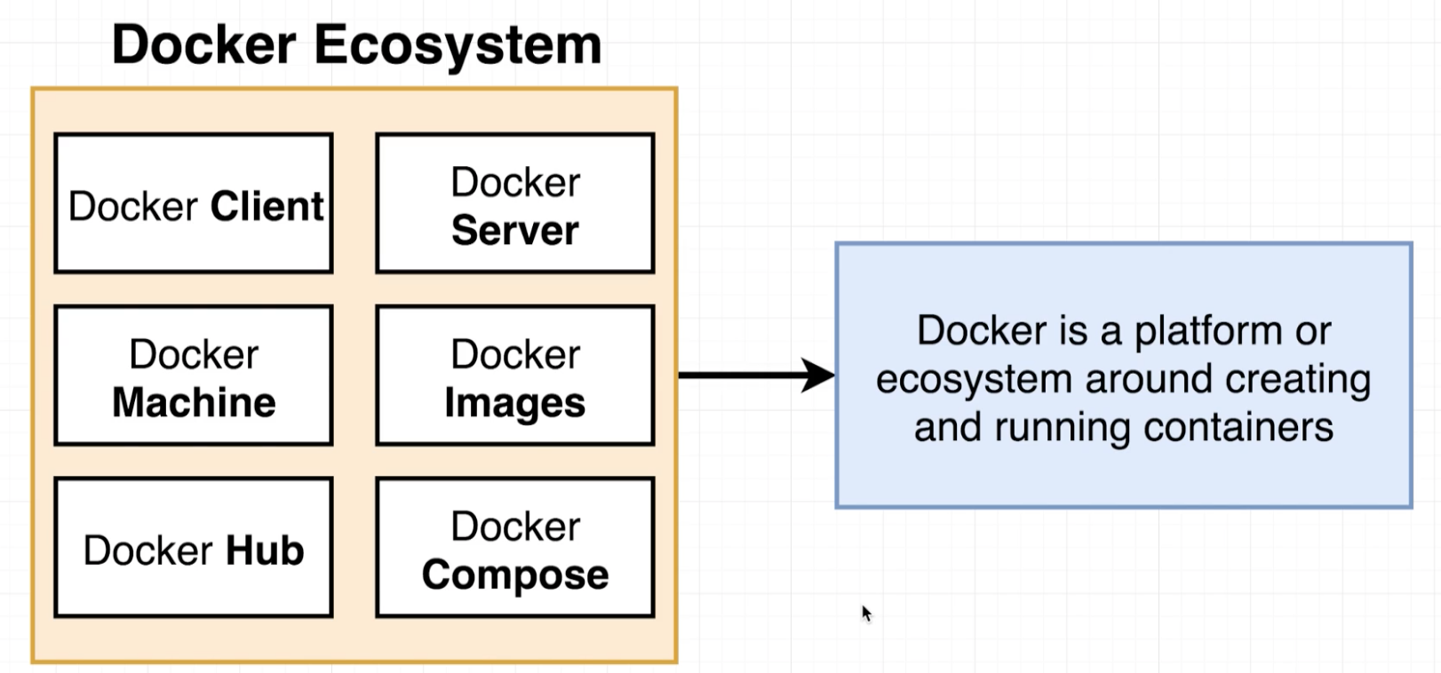
What is Docker/Why we use Docker

Slide 10
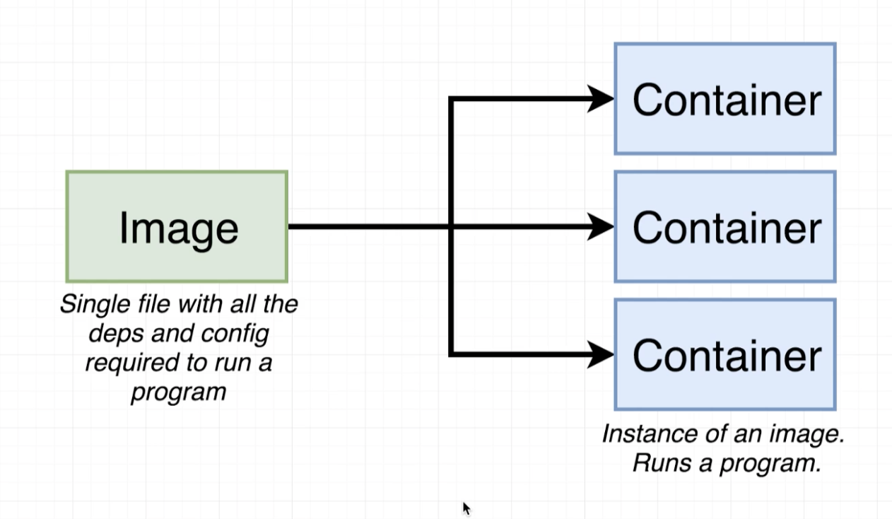
2. Very first Docker terminology

Slide 11
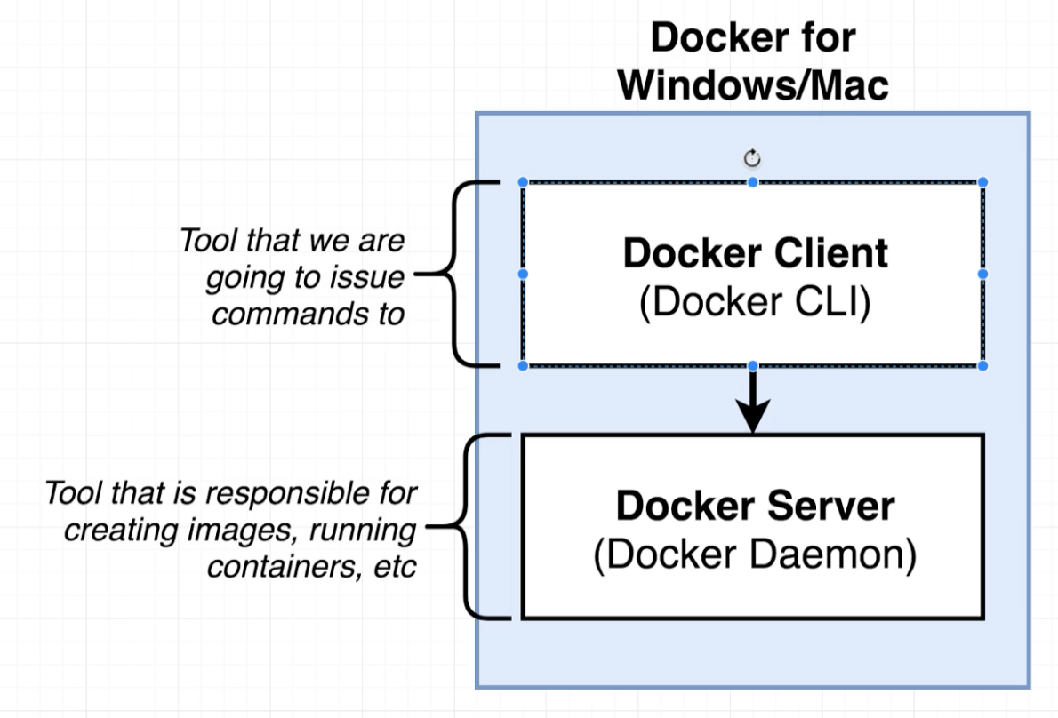
3. Docker for Windows/Mac-Components

Slide 12
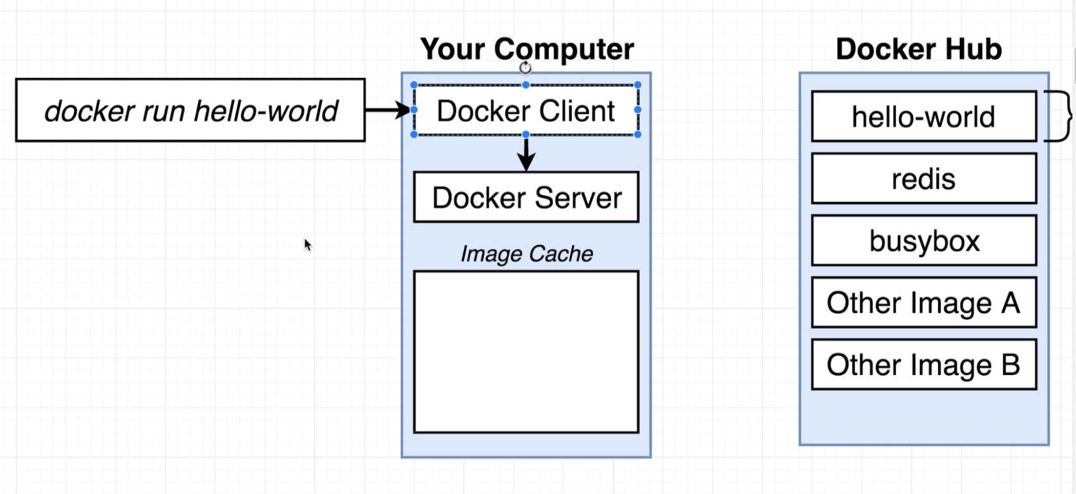
4. Using Docker client
Docker run hello-world

Slide 13
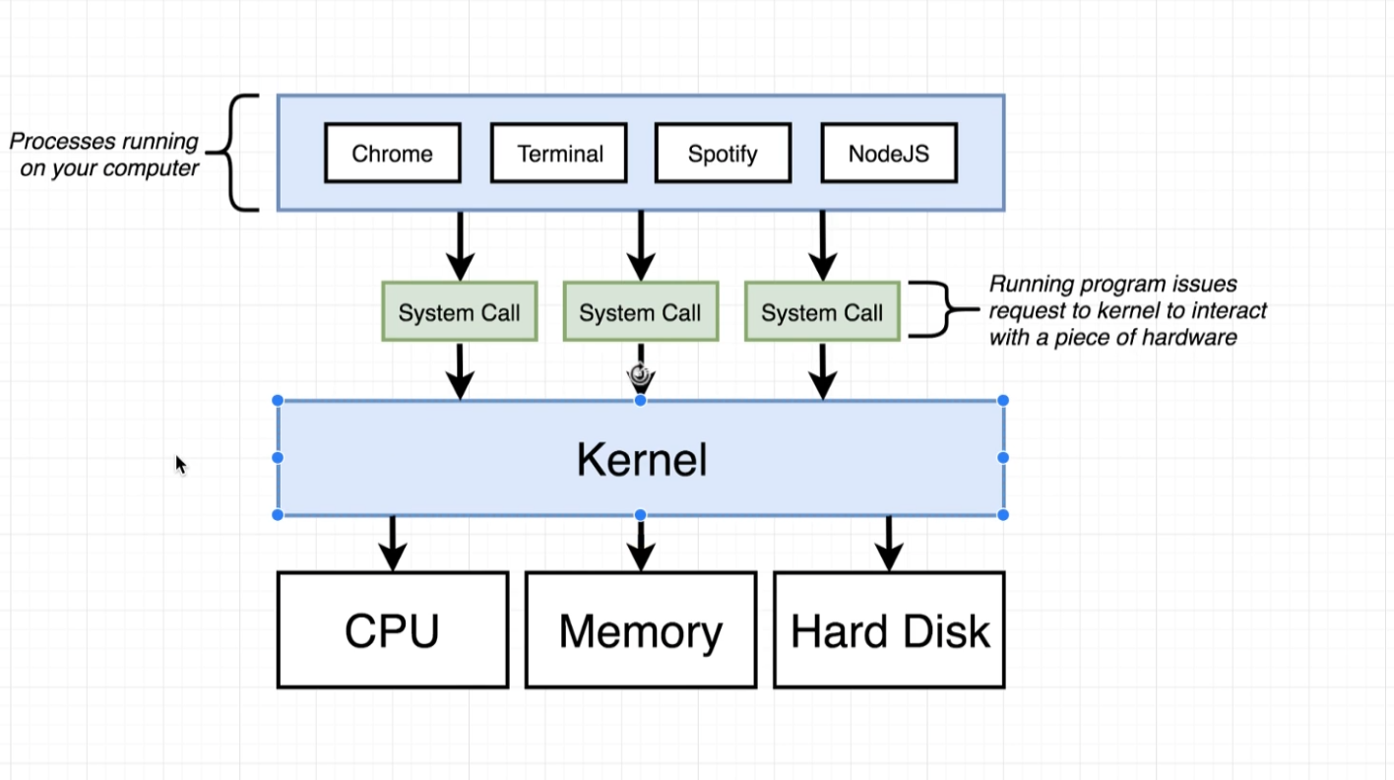
5. A container..

Slide 14
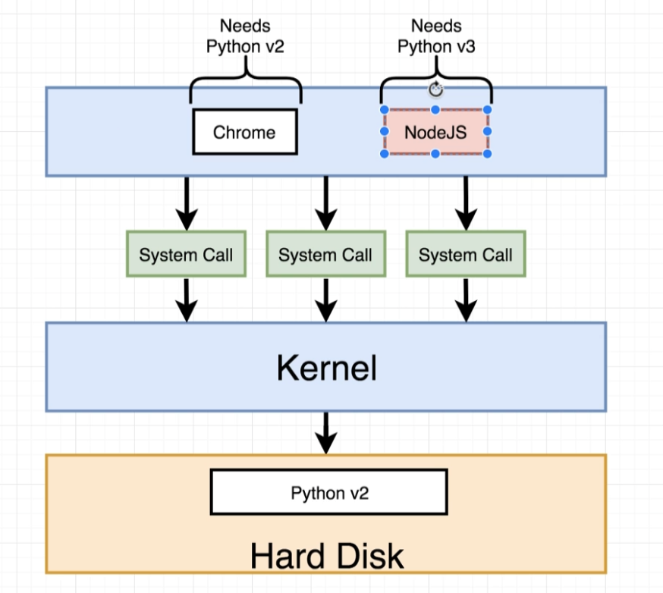
5. A container..

Slide 15
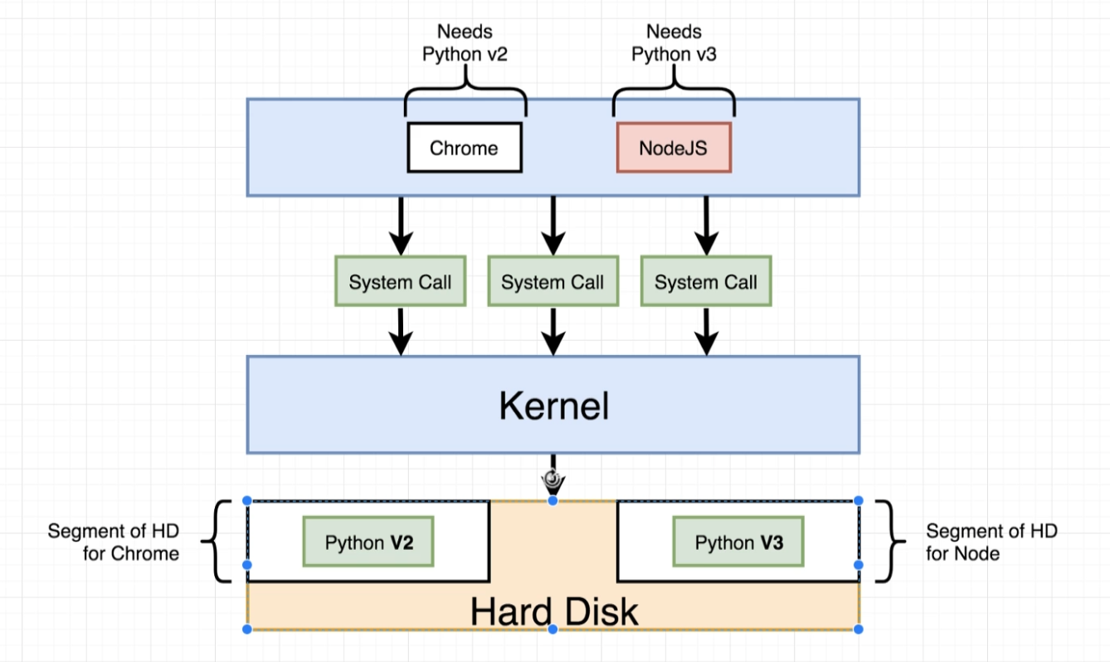
5. A container..

Slide 16
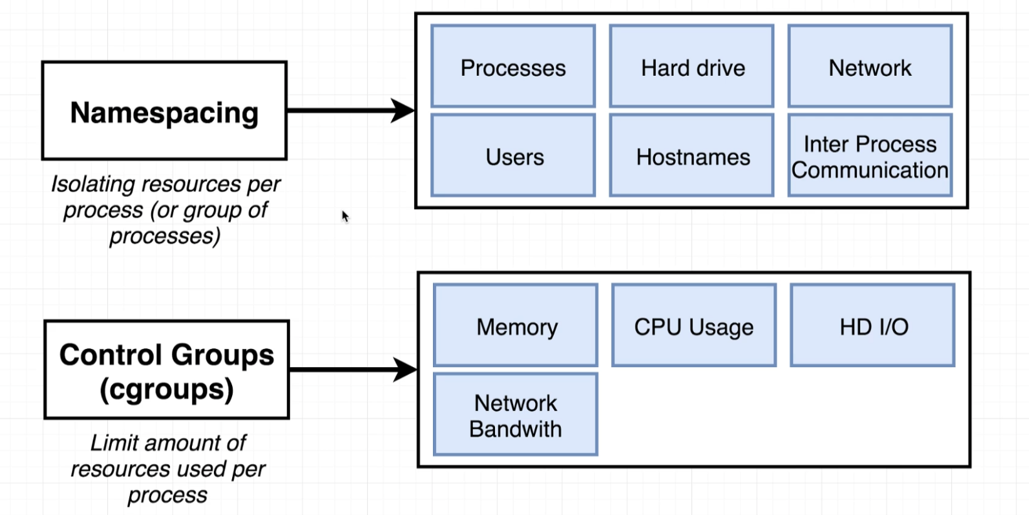
5. A container..

Slide 17
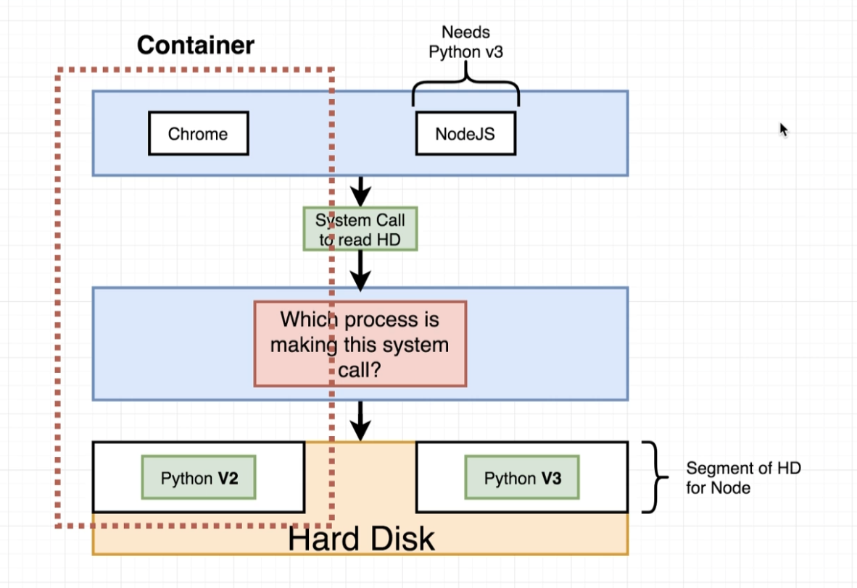
5. A container..

Slide 18
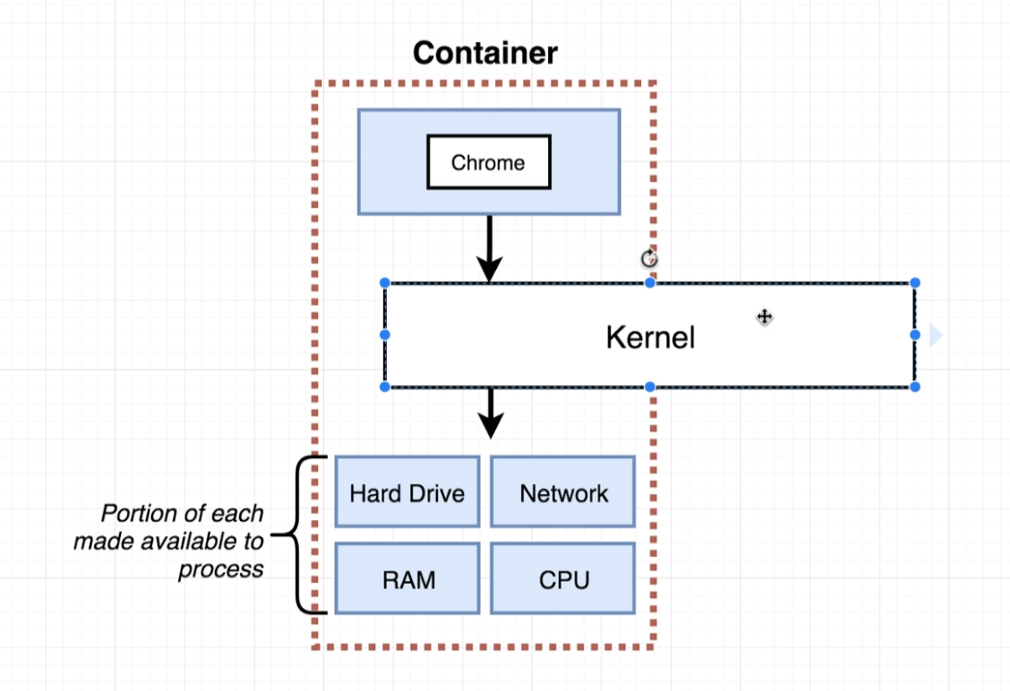
5. A container..

Slide 19
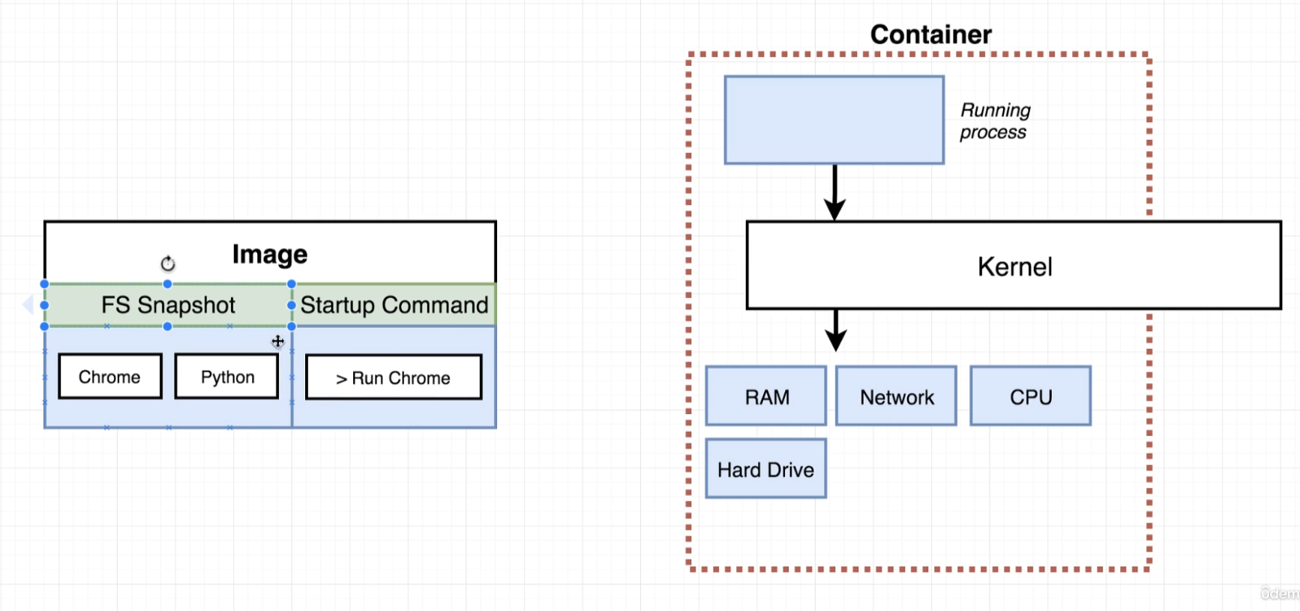
5. A container..

Slide 20
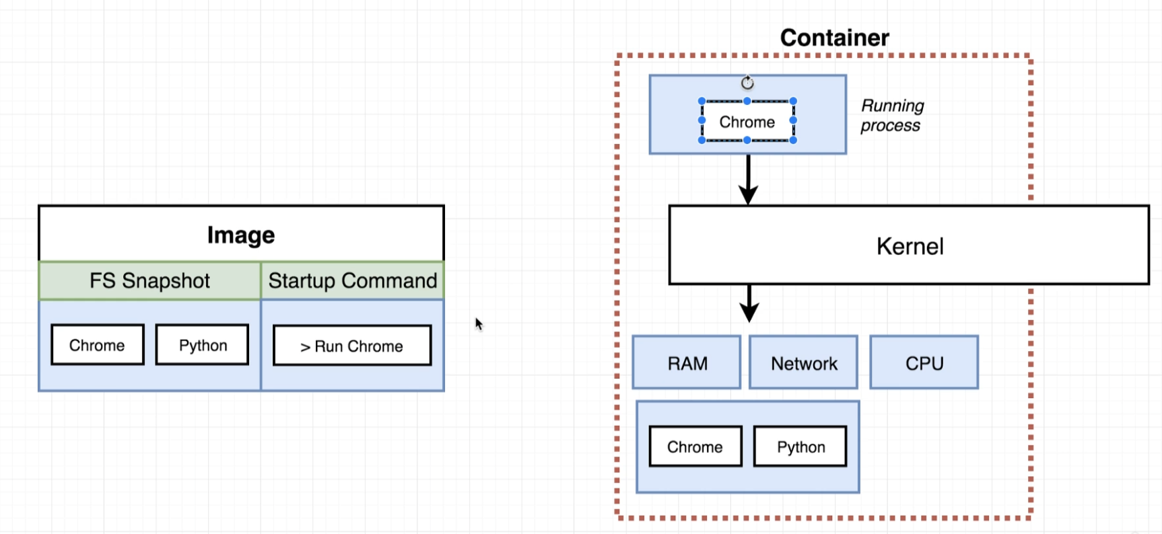
5. A container..

Slide 21
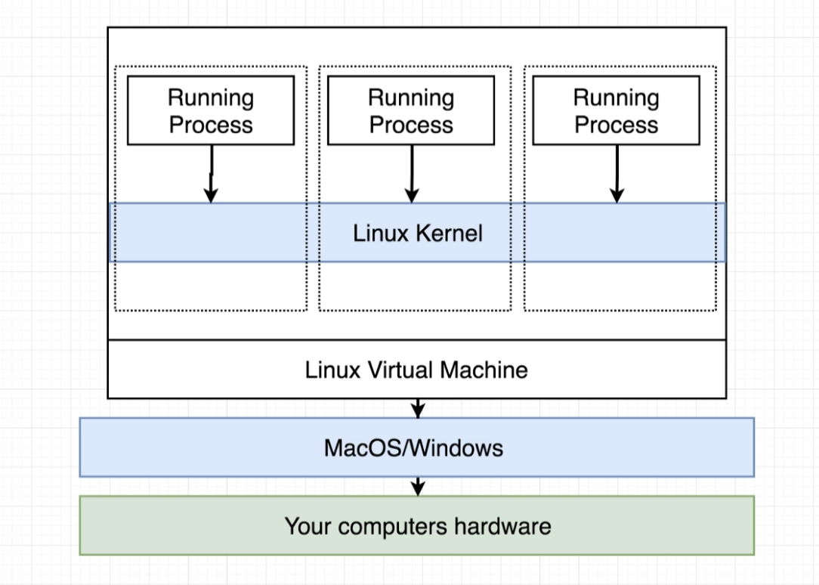
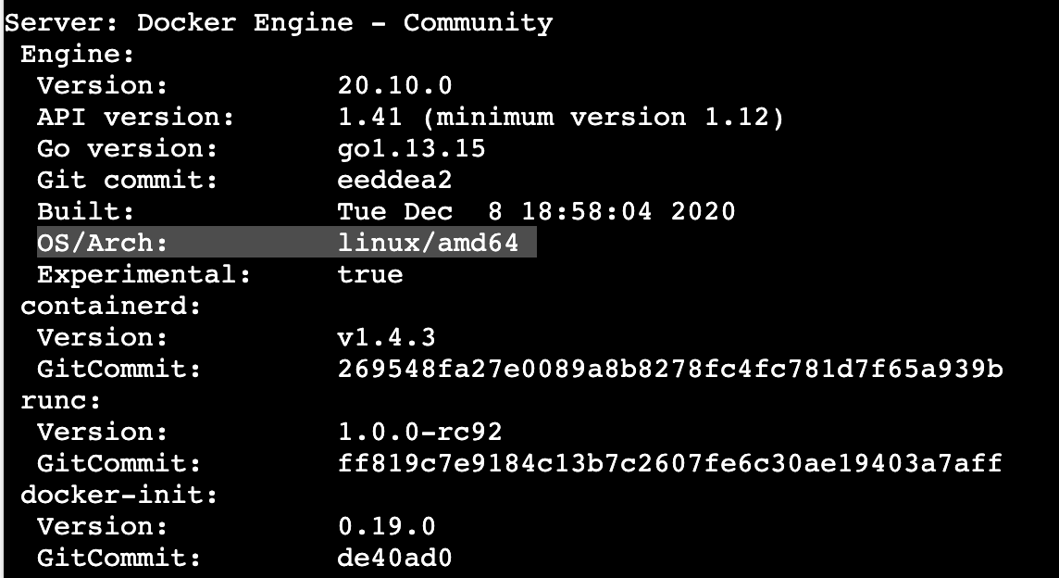
6. How your computer is running Docker

